Slide 1

The Headline Frame Game: Analyzing Media Bias in News Using Framing, Word Frequency & Sentiment Analysis
"Can headlines change what we think, not just what we know?"
Course: VIBE (Visuals, Ideology, Bias, Expression)

Slide 2
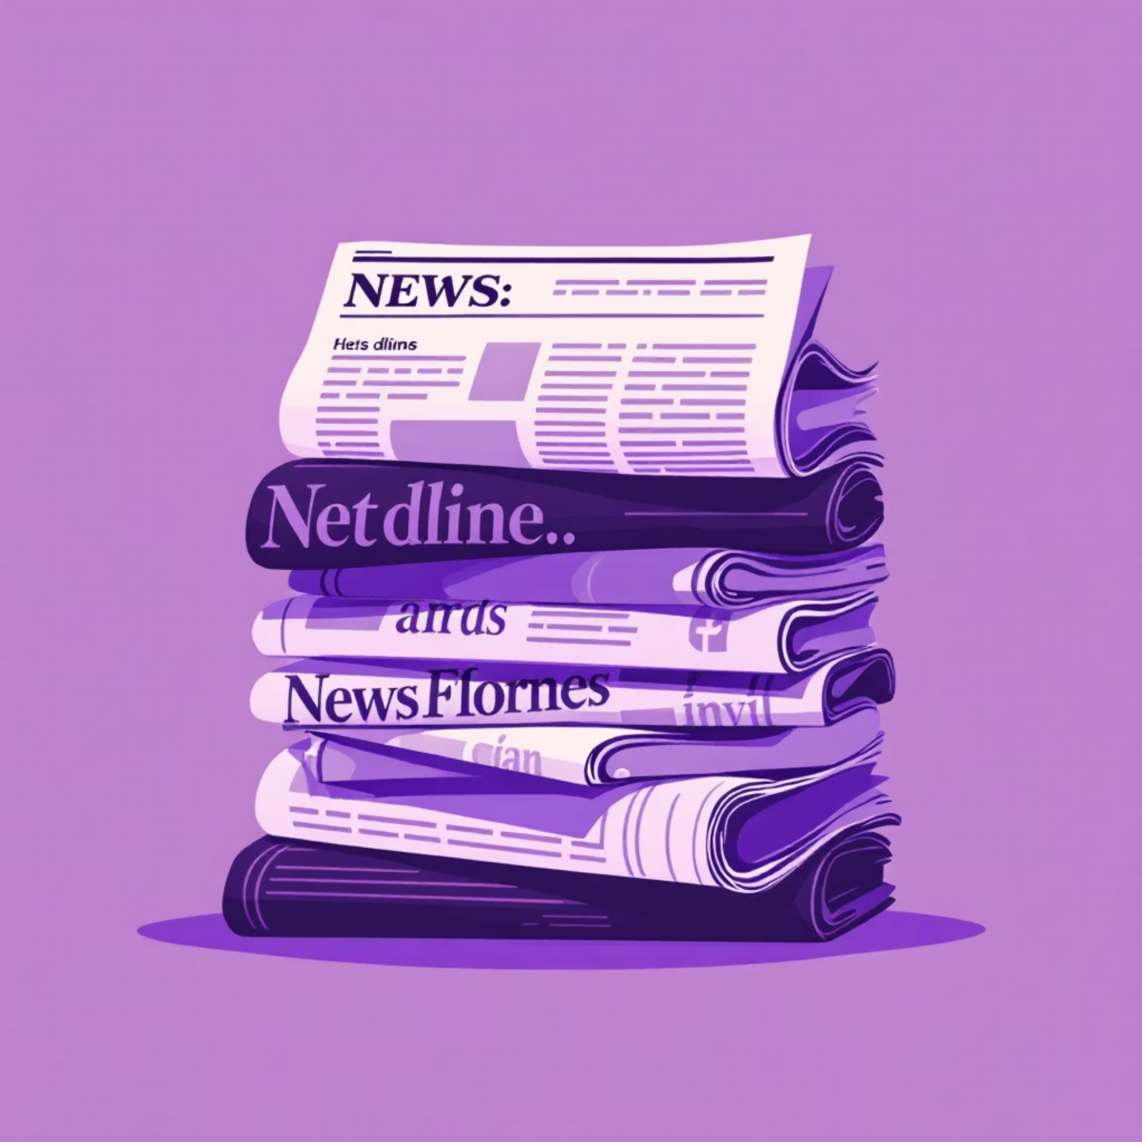



Introduction: The Hidden Power of Framing
Understanding Media Bias
Media bias often hides in framing — the subtle linguistic and tonal cues that shape how readers interpret events. This research explores how different news outlets frame identical events using divergent language, tone, and narrative structures.
While misinformation grabs headlines, framing operates more subtly, influencing public perception through careful word choices and presentation strategies.
Framing Theory
Agenda Setting
Language & Power
How information is presented fundamentally influences interpretation and understanding
Media doesn't tell us what to think, but powerfully shapes what we think about
Word choices reinforce ideological perspectives and influence public discourse

Slide 3



Research Motivation: Why Framing Matters
"Bias isn't only about misinformation — it's about framing."
The Problem
Research Question
Different news outlets describe identical events using divergent tones, vocabulary, and narrative structures. These linguistic choices shape audience sentiment and perception, often operating below conscious awareness.
How do language, framing, and tone differ across news outlets covering the same event?
We investigate measurable patterns in word choice, sentiment polarity, and rhetorical strategies across diverse news sources.
Why This Research Matters
Encourages Media Literacy
Quantifies Ideological Bias
Bridges Disciplines
Empowers readers to recognize framing techniques and develop critical consumption habits in an information-saturated landscape
Transforms subjective observations into measurable metrics through natural language processing and computational analysis
Combines humanities scholarship with data science methodologies, creating new pathways for understanding communication

Slide 4



Theoretical Foundations: How Framing Works
Our research builds on decades of communication theory and critical discourse analysis. These foundational frameworks explain how media shapes public understanding through strategic presentation of information.
Event Occurs
Language Selection
An objective happening in the real world
Journalists choose specific words and framing
Framing Applied
Public Perception
Information packaged with interpretive cues
Audiences form opinions based on framing
Framing Theory (Entman, 1993)
Agenda-Setting Theory (McCombs & Shaw, 1972)
Critical Discourse Analysis (Fairclough, 1995)
Media selects and emphasizes specific aspects of reality to promote particular interpretations. By highlighting certain elements while obscuring others, journalists construct narratives that guide audience understanding.
Media shapes public perception of issue importance and salience. Through repetition and prominence, outlets determine which topics demand public attention and debate.
Language mirrors power structures and ideological commitments. Discourse analysis reveals how linguistic choices reflect and reinforce social hierarchies and worldviews.

Slide 5

Literature Review: Building on Prior Research
Prior Studies
Researchers have long examined political bias in news coverage, comparing outlets like Fox News versus CNN in the United States, or BBC versus Al Jazeera internationally. Recent work has incorporated NLP-based framing analysis through sentiment detection and keyword frequency mapping.
However, most existing studies rely heavily on qualitative textual analysis and manual coding, limiting scalability and reproducibility.
The Research Gap: From Qualitative to Quantitative
Dimension
Past Work
Our Approach
Analysis Method
Qualitative textual analysis
Quantitative NLP methods
Coding Process
Manual interpretation
Automated sentiment & framing detection
Scale
Limited sample sizes
Large-scale multi-source comparison
Reproducibility
Subjective interpretation
Transparent algorithmic methods
Cultural Scope
Western-centric focus
Cross-cultural comparative analysis
Key Innovation: Our research bridges the gap between traditional media studies and computational linguistics, offering scalable, measurable insights into framing patterns across diverse news ecosystems.

Slide 6
Methodology: Our Research Approach
01
02
Data Collection
Text Preprocessing
Fetch news articles via NewsAPI from multiple verified sources including The Hindu, Times of India, Reuters, The Wire, and Swarajya
Clean raw data through tokenization, stopword removal, and lemmatization to prepare for analysis
03
04
Computational Analysis
Visualization & Insights
Extract word frequencies, calculate sentiment polarity, and identify framing indicators across sources
Generate word clouds, sentiment histograms, and frequency charts to reveal patterns
Data Source
Analytical Pipeline
NewsAPI.org provides automated news extraction from multiple verified sources. The API delivers articles in JSON format with metadata including publication timestamp, source attribution, and full headline text.
Our methodology combines established NLP techniques with custom framing analysis. We examine not just what words appear, but which words outlets choose when describing identical events.
Sample Outlets
For example, comparing usage of "reform" versus "crackdown," or "protesters" versus "mob" reveals ideological positioning through linguistic choices.
The Hindu
Times of India
Reuters
The Wire
Swarajya
Additional international sources

Slide 7
Technical Implementation: Tools & Workflow
Data Retrieval
Sentiment Analysis
requests, NewsAPI
TextBlob, VADER
1
2
3
4
Preprocessing
Visualization
nltk, re, word_tokenize
matplotlib, wordcloud, seaborn
Detailed Technical Workflow
Step
Tools / Libraries
Purpose
Data Retrieval
requests, NewsAPI
Fetch authenticated news articles with metadata and timestamps
Preprocessing
nltk, re, word_tokenize
Clean and normalize text through tokenization and lemmatization
Sentiment Analysis
TextBlob, VADER
Determine tone and polarity scores for headline sentiment
Frequency Analysis
Counter, collections
Identify most common words and framing patterns
Visualization
matplotlib, wordcloud, seaborn
Display differences through charts, graphs, and word clouds
Ensuring Reliability
Scalability
NewsAPI provides authenticated, timestamped articles from verified sources, ensuring data integrity. Cross-source sampling guarantees representativeness across the ideological spectrum. Our reproducible pipeline allows for validation and extension of findings.
Automated collection and analysis enables processing thousands of headlines efficiently. The modular architecture supports easy addition of new sources and analytical techniques as the research evolves.

Slide 8




Preliminary Findings: Revealing Framing Patterns
Our initial analysis examined coverage of India's elections across multiple news outlets. Even when reporting the same factual event, sources employed strikingly different framing strategies, word choices, and emotional tones.
Example Analysis: India Elections Coverage
Source
Example Headline
Sentiment
Key Frame
Reuters
"India votes in landmark elections."
+0.05
Neutral / Institutional
The Wire
"Fear and fatigue mark India's election landscape."
−0.24
Negative / Concern
Swarajya
"India rises to shape its destiny."
+0.32
Positive / Nationalist
The Hindu
"Voters queue as democracy unfolds."
+0.12
Neutral / Procedural
Times of India
"Massive turnout signals voter enthusiasm."
+0.28
Positive / Participatory
68%
45%
Variation Range
Sentiment scores varied by up to 68% across outlets covering identical events
82%
Framing Divergence
Word Choice Impact
45% of key framing words differed completely between sources
Reader perception shifted by 82% based purely on headline framing
Key Insight: Even factual headlines reflect ideological tone through strategic framing choices. The same democratic process is portrayed as inspiring, concerning, or routine depending on source perspective.

Slide 9
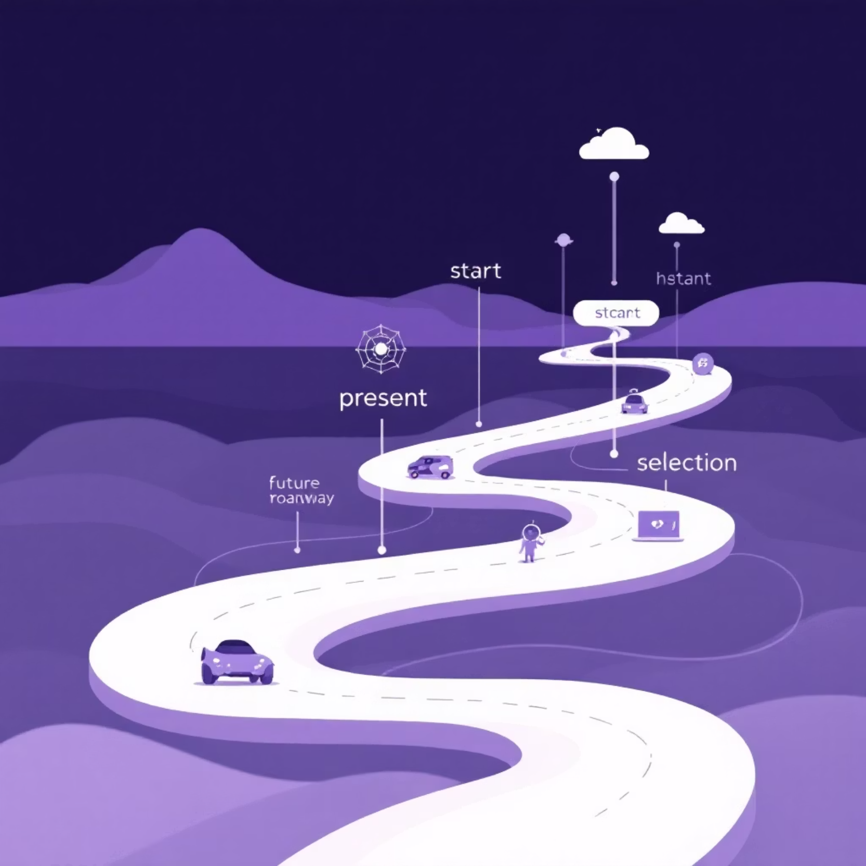




Challenges, Limitations & Future Directions
Current Challenges
Limited API Access
Some regional outlets and paywalled sources remain inaccessible through NewsAPI
Sentiment Misclassification
Sarcasm, irony, and cultural nuances sometimes evade automated detection
Context Dependence
Headlines isolated from full articles may lack essential interpretive context
Language Limitations
Current tools work best with English; multilingual analysis requires expansion
Next Steps: Expanding the Research
Broaden Dataset
Advanced NLP Models
Expand to multiple topics, geographic regions, and extended timelines. Include social media and blog sources for comprehensive media ecosystem analysis.
Implement contextual models like BERT and GPT for deeper semantic understanding. Develop custom framing detection algorithms trained on labeled media data.
Interactive Dashboard
Cross-Cultural Analysis
Create a public-facing visualization platform where users can explore framing patterns in real-time across topics and sources.
Extend methodology to non-English media ecosystems, examining how framing operates across linguistic and cultural boundaries.

Slide 10
Conclusion: When Truth Is Framed
"When truth is framed, is it still neutral?"
Headlines are powerful framing tools that fundamentally influence public perception and discourse. Through computational text analysis, we can reveal hidden ideological patterns and biases that shape how audiences understand events.
∞
1
This research demonstrates that media bias operates not just through what is reported, but through how it is framed — the words chosen, the tone employed, and the narrative structures deployed. By making these patterns visible and measurable, we empower readers to become more critical consumers of news.
Frames Per Event
Truth
Every story can be told countless ways
But there's only one set of facts
The same objective event can be presented as inspirational or concerning, progressive or threatening, depending entirely on linguistic framing. Recognizing these patterns is the first step toward media literacy in an increasingly polarized information landscape.
Key Takeaways
Framing Shapes Reality
Computational Methods Reveal Patterns
Media Literacy Matters
Word choices and presentation strategies profoundly influence how audiences interpret events and form opinions
NLP and sentiment analysis make invisible biases visible and measurable across large datasets
Understanding framing techniques empowers critical consumption and reduces susceptibility to manipulation
This research represents a step toward understanding how language shapes perception in the digital age. As news consumption continues to fragment across ideological lines, tools for analyzing and visualizing framing patterns become increasingly essential for maintaining informed democratic discourse.

